Slide 1
1
EduFinder
Elvin Garayev, Ali Ahmadli, Ulviyya Mammadova, Ziyavaddin Zeynalli, Sama Zeynalova

Slide 2
2
Introduction

Slide 3
3
What are the strengths?
More creative learning style
Easily find a tutor or student
Education level
Timetable

Slide 4
4
Hardware and Software Specification
Web server: Linux CentOs
Application Server: Linux CentOs
Database Server: Linux CentOS
Web server: Apache
Application Server: Python
Database Server: MySQL
Application Server: Six-core Xeon
Database Server: 10-TB disk drive RAID Eight core Xeon
Operating System
Special Software
Hardware

Slide 5

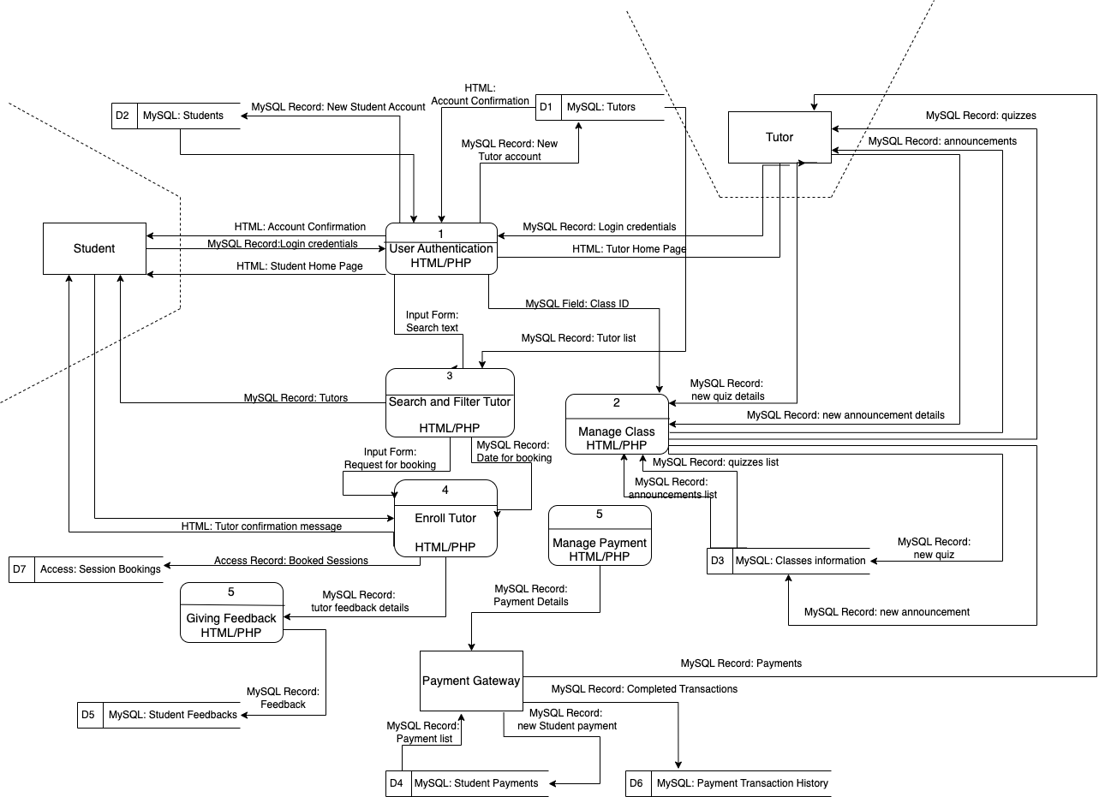
5
Program Design

Slide 6
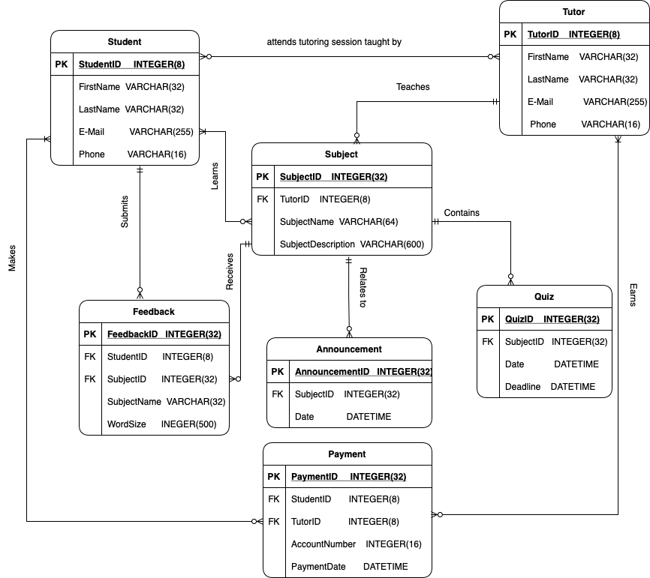
6
Data Storage Design

Slide 7
7
01
ALLPPT Layout Clean Text Slide
References
02
ALLPPT Layout Clean Text Slide
03
ALLPPT Layout Clean Text Slide
04
ALLPPT Layout Clean Text Slide

Slide 8
8
THANK YOU

